Slide 1
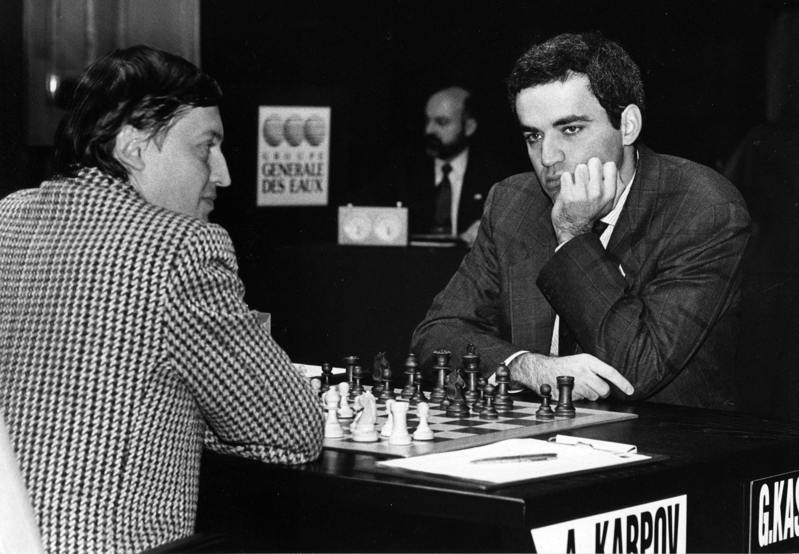

Slide 2

The Machine Learning Process
using a decision tree model
Part 01
Reza Dibaj

Slide 3
Outline
What is Machine Learning? Difference between apple and orange
What is Classifier?
Supervised Learning Recipe
Collect Training Data
Train Classifier
Make Predictions

Slide 4
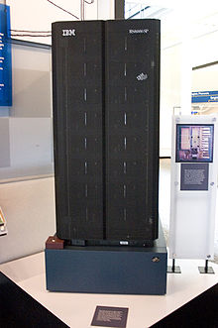
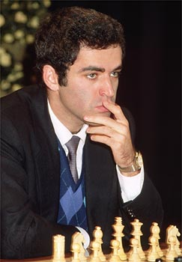
What is Machine Learning?
Subfield of Artificial Intelligence (AI)
Early AI programs typically excelled at one specific task
e.g. Deep Blue (chess computer)
VS
IBM Deep Blue
Garry Kasparov

Slide 5
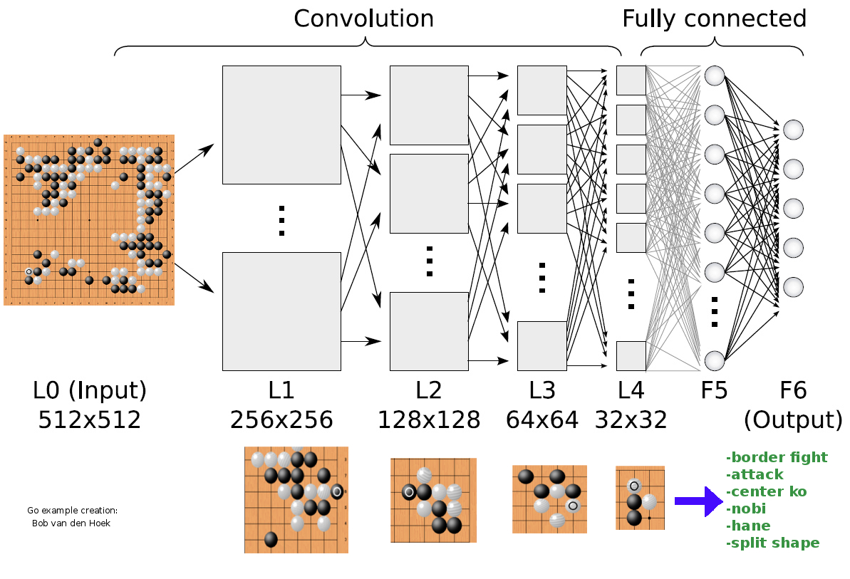
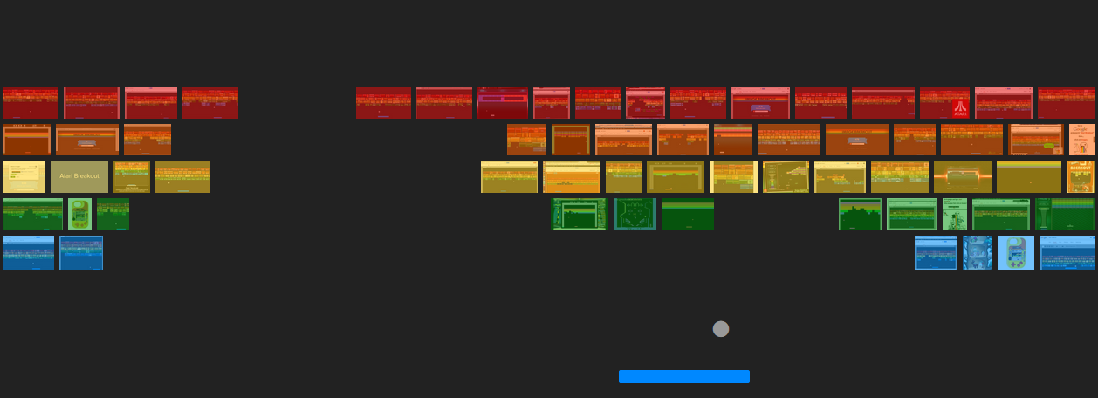

What is Machine Learning?
Writing one program that can solve a number of problems without needing to be rewritten
Notes:
We want to write one program that can solve many problems without needing to be rewritten

Slide 6

What is Machine Learning?
Machine Learning: algorithms that learn from examples and experience, instead of relying on hard-coded rules

Slide 7
What is Machine Learning?
Traditional Programming vs Machine Learning
Rules
Traditional
Programming
Answers
Data
Answers
Machine
Learning
Rules
Data

Slide 8
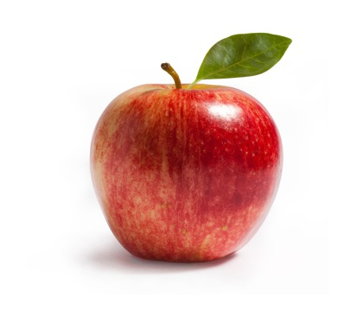

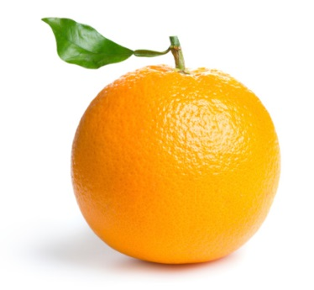
Difference between apple and orange
Write a program to take an image file as input, does some analyses, and output the type of fruit:
“Apple”
“Orange”

Slide 9

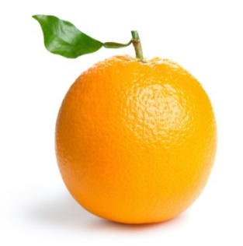
Difference between apple and orange
Counting the number of orange pixels and green pixels
Calculate the ratio
Notes:
Write a program to take an image file as an input, does some analyses, and output the type of the fruit:
Counting the number of orange pixels and green pixels
Calculate the ratio

Slide 10
Difference between apple and orange
Classical programming approach:
def detect_colors(image):
# lots of code
def detect_edges(image):
# lots of code
def analyse_shapes(image):
# lots of code
def guess_texture(image):
# lots of code
def define_fruit(image):
# lots of code
def handle_probability(image):
# lots of code

Slide 11
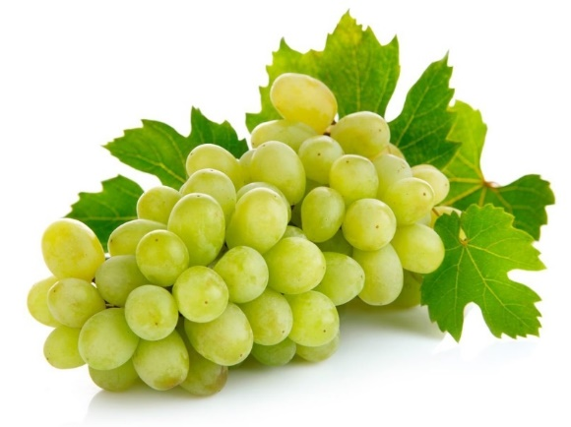
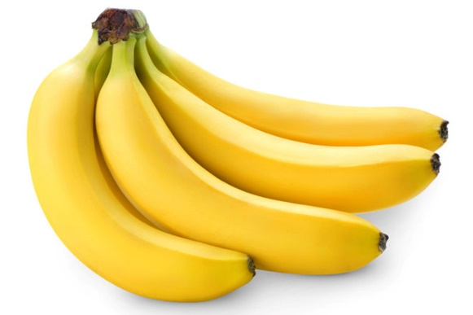
Difference between apple and orange
How about writing a program to handle black-and-white photo?
How about the images that contain other types of fruit?
?
?
Notes:
That works fine for simple images like these. But as you dive deeper into the problem, you will find the real world is messy, and the rules you write start to break.
How about writing a program to handle black-and-white photo?
How about the images that contains other types of fruits?

Slide 12

What is Classifier?
Machine Learning is all about the algorithms that can define these rules for us.
For that we are going to train a classifier.
f(x) = y
“Spam”
“Apple”
Features
Label
Notes:
Clearly we need something better. To solve this, we need an algorithm that can figure out the rules for us, so we do not have to write them by hand.
And for that we are going to train a classifier.
For now, you can think of a classifier as a function.
Classifier is similar to a function that takes some data as input and assigns label to it as output.

Slide 13
What is Classifier?
The technique to write the classifier automatically is called Supervised Learning.
It begins with examples of a problem you want to solve by finding patterns in these examples.

Slide 14
What is Classifier?
What does it mean to learn from data?
f(x) = y
Features
Label
def Classify(features):
# do some logic
return label
Notes:
Earlier, we mentioned that we call the features X and the labels Y, as they were the input and output of a function.
As we already know in supervised learning, we do not want to write this function ourselves. We want an algorithm to learn it from training data.
So, what is it mean to learn a function?

Slide 15
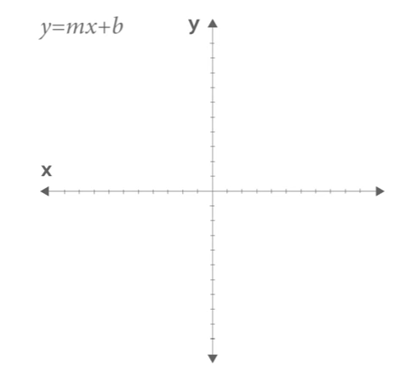
What is Classifier?
What does it means to learn a function?
Notes:
So, what does it mean to learn a function?
Function is just a mapping from input to output values.
Here is a function you might have seen before:
y = mx+b
That is the equation for a line, and there are two parameter: m which gives you the slope; and b, which gives you the y-intercept.
Given these parameters, of course, we can plot the function for different values of x.

Slide 16
What is Classifier?
How a classifier works as a function?
x
def Classify(features):
# do some logic
return label
y
Notes:
In supervised learning, our classified function might have some parameters as well.
But the input x are the features that we want to classify, and the output y is a label, like Spam or Not Spam, or type of a flower.

Slide 17
What is Classifier?
What could the body of the function look like?
def Classify(features):
# do some logic
return label
Notes:
What could the body of the function look like?
That is the part that we want to write algorithmically, or in other words learn.
The important thing to understand here is we are not starting from the scratch and pulling the body of the function out of thin air. Instead, we start with a model.
You can think of a model as the prototype for or the rules that define the body of our function.

Slide 18
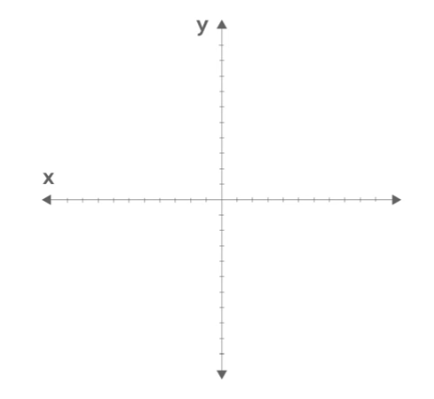
What is Classifier?
Distinguishing between red dots and green dots:
Notes:
Typically, a model has parameters that we can adjust with our training data.
And here is a high-level example of how this process works.
Let’s look at a toy dataset and think about what kind of model we could use as a classifier.
Pretend we are interested in distinguishing between red dots and green dots, some of which I have drawn here on a graph. To do that we will use just two features: the x and y coordinate of a dot.

Slide 19
What is Classifier?
How can we classify any data?
Red or green?
Notes:
Now let’s think about how we could classify this data. We want a function that considers a new dot that has never seen before, and classifies it as red or green.
In fact, there might be a lot of data we want to classify.

Slide 20
What is Classifier?
How can we classify any data?
Notes:
Here I have drawn our testing examples in light green and light red. These are dots that were not in our training data. The classifier has never seen them before, so how can it predict the right label?

Slide 21
What is Classifier?
How can we classify any data?
Classifier
Notes:
Imagine if we could somehow draw a line across the data.
Then we could say the dots to the left of the line are green and the dots to the right of the line are red.
The question is: How can we learn this line?

Slide 22
What is Classifier?
How can we classify any data?
m = 2
b = 1
Notes:
One way is to use the training data to adjust the parameters of a model.
And the model we use is a simple straight line like we saw before. In other words, we have two parameters to adjust: m and b
And by changing them, we can change where the line appears.

Slide 23
What is Classifier?
How could we learn the right parameters?
One idea is that we can iteratively adjust the parameters using the training data
Notes:
For example, we might start with a random line and use it to classify the first training example. If it gets it right, we do not need to change our line, so we move on to the next one.

Slide 24
What is Classifier?
How could we learn the right parameters?
Notes:
But on the other hand, if it gets wrong, we can slightly adjust the parameters of our model to make it more accurate.
The takeaway here is this: One way to think of learning is using training data to adjust the parameters of a model.

Slide 25
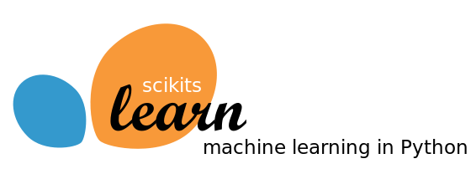

Supervised Learning Recipe
scikit-learn
Click here for more info
TensorFlow
Click here for more info
Go to the installation part
Notes:
Six lines of code is all it takes to write your first Machine Learning program.

Slide 26
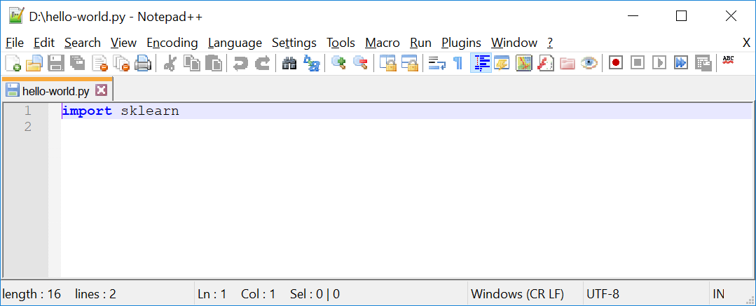
Supervised Learning Recipe
Now create a file, named hello-world.py as follows:
Notes:
Hello-world.py
import sklearn
Command line:
python hello-world.py

Slide 27
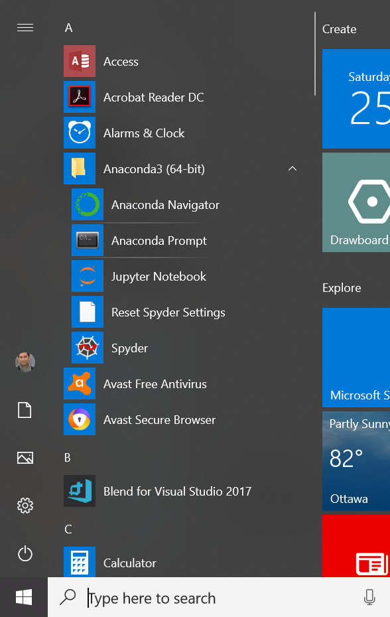
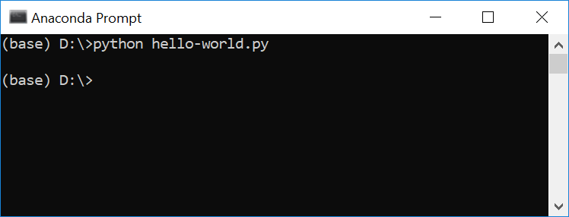
Supervised Learning Recipe
Go to your program and open your Anaconda3 (64bits) and then Anaconda prompt. After that go to the directory that you have created your hello-world.py and type: python hello-world.py↵
Notes:
Hello-world.py
import sklearn
Command line:
python hello-world.py

Slide 28
Supervised Learning Recipe
Collect Training Data
Training Classifier
Make Predictions

Slide 29
Supervised Learning Recipe
Collect Training Data
Training Classifier
Make Predictions

Slide 30
Supervised Learning Recipe
Collect Training Data
The more data we have, the better classifier we can make.
Features
Weight | Texture | Label
150g | Bumpy | Orange
170g | Bumpy | Orange
140g | Smooth | Apple
130g | Smooth | Apple
… | … | …
Examples
Notes:
Imagine we head out to an orchard.

Slide 31
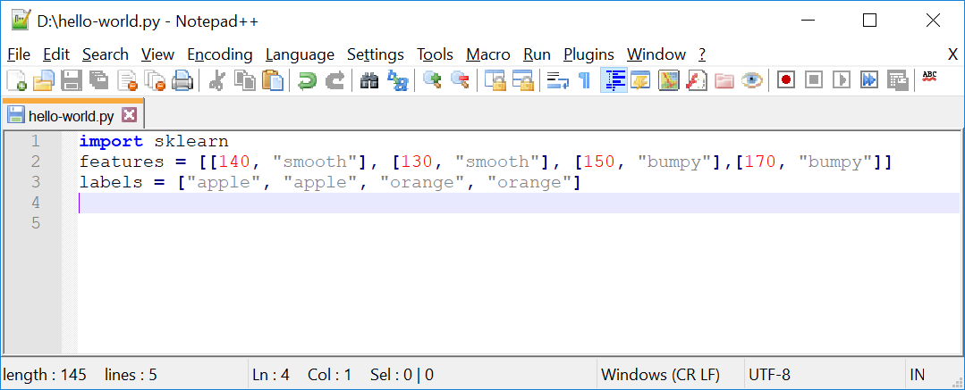
Supervised Learning Recipe
Collect Training Data
Let’s get back to our “hello-world.py” file:
Input
Output
Notes:
import sklearn
features = [[140, "smooth"], [130, "smooth"], [150, "bumpy"],[170, "bumpy"]]
labels = ["apple", "apple", "orange", "orange"]

Slide 32
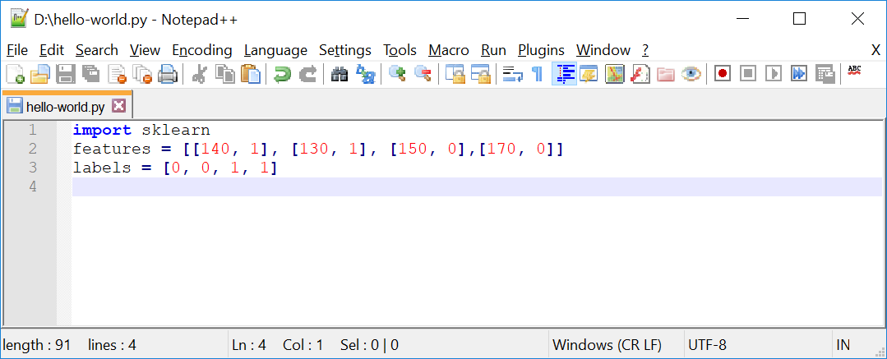
Supervised Learning Recipe
Collect Training Data
Replacing features and labels with integer values.
Input
Output
Notes:
import sklearn
features = [[140, 1], [130, 1], [150, 0],[170, 0]]
labels = [0, 0, 1, 1]

Slide 33
Supervised Learning Recipe
Training Classifier
Training classifier using a decision tree model:
Collect Training Data
Training Classifier
Make Predictions

Slide 34
Supervised Learning Recipe
Training Classifier
We use Decision Tree as our classifier and let’s assume it as a box of rules for now.
Weight > 150g?
Yes
No
Texture = bumpy?
Yes
No
Orange
Apple

Slide 35
Supervised Learning Recipe
Training Classifier
Why Decision Tree?
Easy to read and understand
One of the few models that are interpretable
Notes:
A trick to build an effective tree is to understand which question to ask and when.
And to do that we need to quantify how much a question helps to un-mix the labels.
Gini Impurity: We can quantify the amount of uncertainty at a single node
Information gain: We can quantify how much a question reduces that uncertainty.
We use these two above parameters to find the best question to ask at each point and given that question we will recursively build the tree on each of the new nodes.
We continue building the data until there are no further questions to ask, at which point we will be at leaf.

Slide 36
Supervised Learning Recipe
Training Classifier
We have different classifiers, and decision tree is one of them.
160g Bumpy
“Orange”
Notes:
Different classifiers:
Linear Classifiers: Logistic Regression, Naive Bayes Classifier
Support Vector Machines (SVM)
Decision Trees
Boosted Trees
Random Forest
Artificial Neural Networks (ANN)
Nearest Neighbor

Slide 37
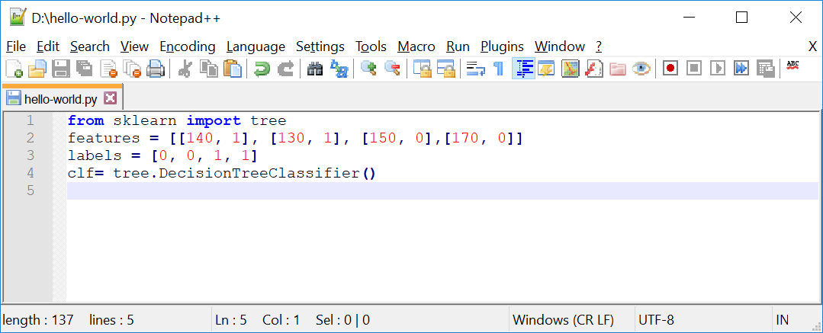
Supervised Learning Recipe
Training Classifier
At this point we define a classifier which is a box of rules. It does not know anything about “apple” and “orange” yet. To train it we need a learning algorithm.
Notes:
from sklearn import tree
features = [[140, 1], [130, 1], [150, 0],[170, 0]]
labels = [0, 0, 1, 1]
clf= tree.DecisionTreeClassifier()

Slide 38



Supervised Learning Recipe
Training Classifier
If we consider a classifier as a box of rules, then we can assume a learning algorithm as the procedure that creates those rules. It does that by finding patterns in our training data.

Slide 39
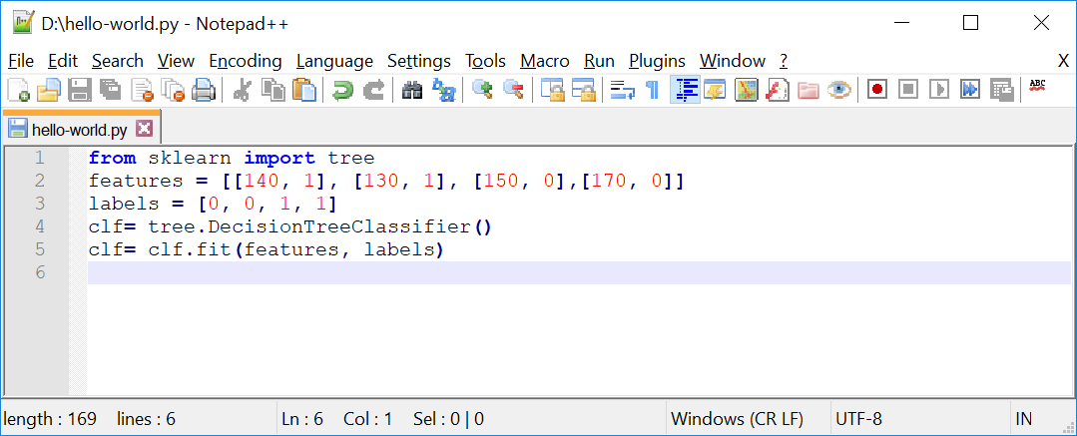
Supervised Learning Recipe
Training Classifier
In scikit the training algorithm is included in the classifier object and is called fit, which is finding patterns in data.
Notes:
Important: We can think of fit as find patterns in data.
We will get into details of how this happens under the hood in a future presentation.
from sklearn import tree
features = [[140, 1], [130, 1], [150, 0],[170, 0]]
labels = [0, 0, 1, 1]
clf= tree.DecisionTreeClassifier()
clf= clf.fit(features, labels)

Slide 40
Supervised Learning Recipe
Make Predictions
Collect Training Data
Training Classifier
Make Predictions

Slide 41
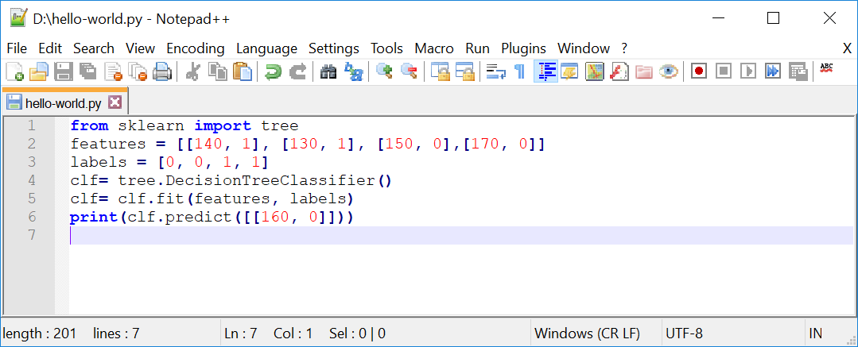
Supervised Learning Recipe
Make Predictions
Now its time to make a prediction. So let’s take it for a spin and use it to classify a new fruit. What is your guess in this example?
Notes:
from sklearn import tree
features = [[140, 1], [130, 1], [150, 0],[170, 0]]
labels = [0, 0, 1, 1]
clf= tree.DecisionTreeClassifier()
clf= clf.fit(features, labels)
print(clf.predict([[160, 0]]))

Slide 42
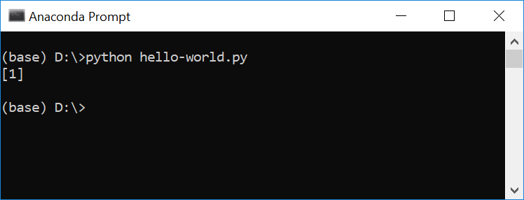
Supervised Learning Recipe
Make Predictions
That is true, as it is bumpy and heavier, it should be orange or 1.

Slide 43
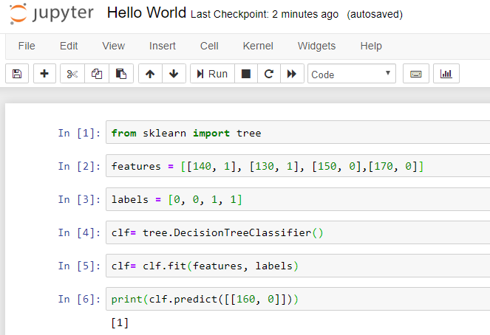
Supervised Learning Recipe
Make Predictions
That is true, as it is bumpy and heavier, it should be orange or 1.

Slide 44
Supervised Learning Recipe
Using the same program for a new problem
Defining a new classifier for a new problem, by changing the training data
Far more reusable than writing new rules for each problem
The more data we have, the better classifier we can make
Horsepower | Seat | Label
300 | 2 | sport-car
450 | 2 | sport-car
200 | 8 | minivan
150 | 9 | minivan
… | … | …
Notes:
This makes this approach far more reusable than writing new rules for each problem.

Slide 45




Supervised Learning Recipe
We can create a new classifier for a new problem, just by changing the training data.
This approach is far more reusable than writing new rules for each problem.
Question:
Could we use images instead of variables?
Image | Label
 | Orange
 | Orange
 | Apple
 | Apple

Slide 46
Important Concepts
How does this work in the real world?
How much training data do we need?
How is the tree created?
What makes a good feature?

Slide 47

Thank you
Question?
To be
Not to be

Slide 48

Appendix:
Installation Process of
Anaconda Distribution of Python on Windows

Slide 49
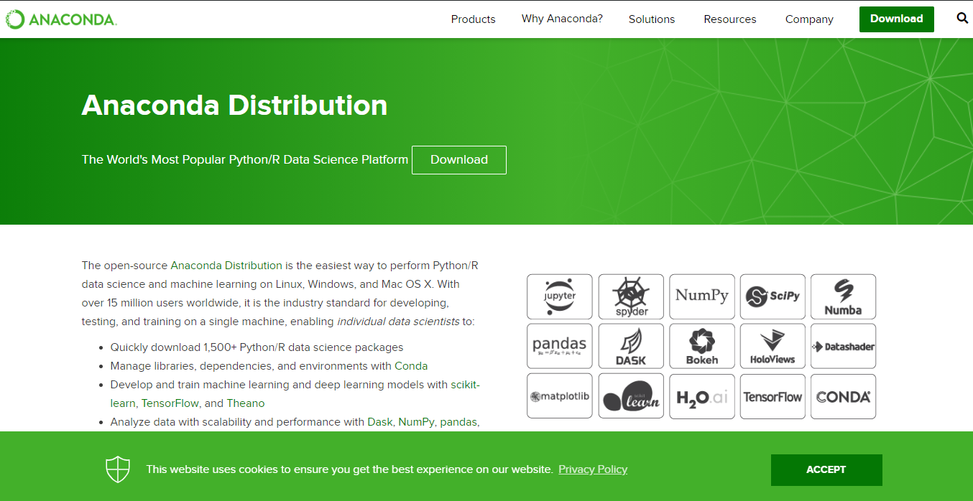
Anaconda Distribution of Python
Notes:
https://www.anaconda.com/distribution/

Slide 50
Anaconda Distribution of Python
2
1

Slide 51

Anaconda Distribution of Python
1
2

Slide 52
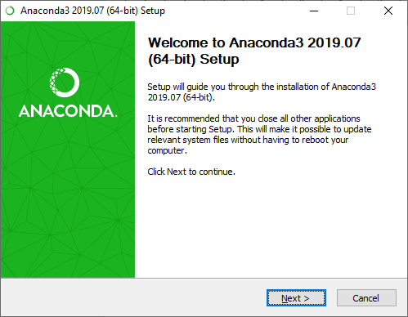
Installation Process
1
2

Slide 53
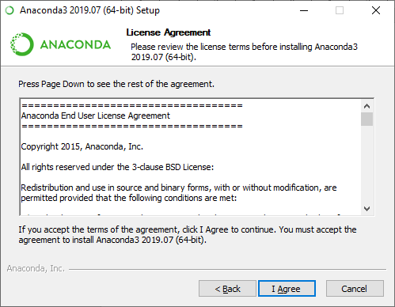
Installation Process

Slide 54
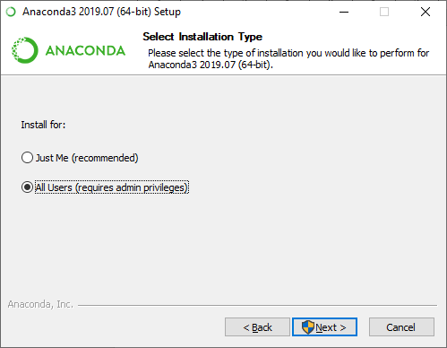
Installation Process
1
2

Slide 55
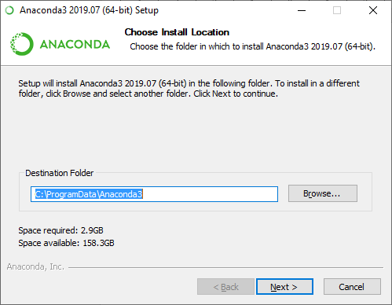
Installation Process
You can change the installation path or leave it as it is.
1
2

Slide 56
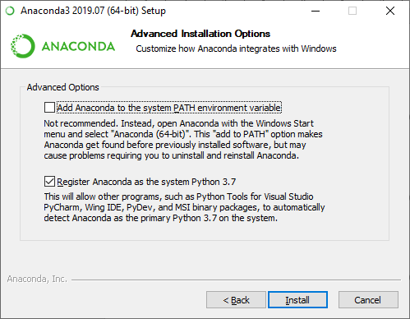
Installation Process

Slide 57
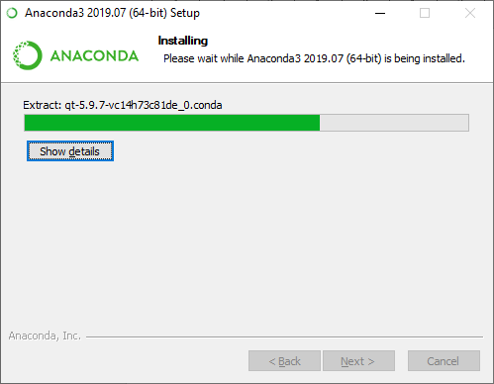
Installation Process

Slide 58
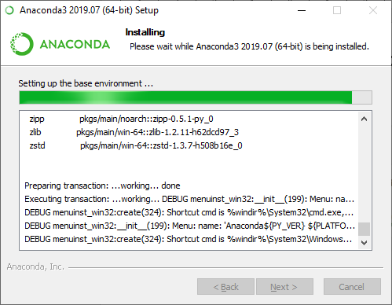
Installation Process

Slide 59
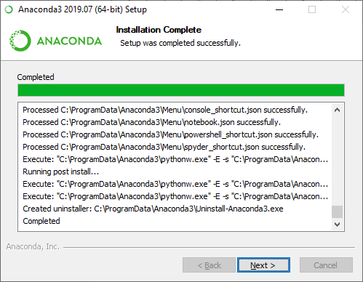
Installation Process

Slide 60

Installation Process

Slide 61

Installation Process

Slide 62
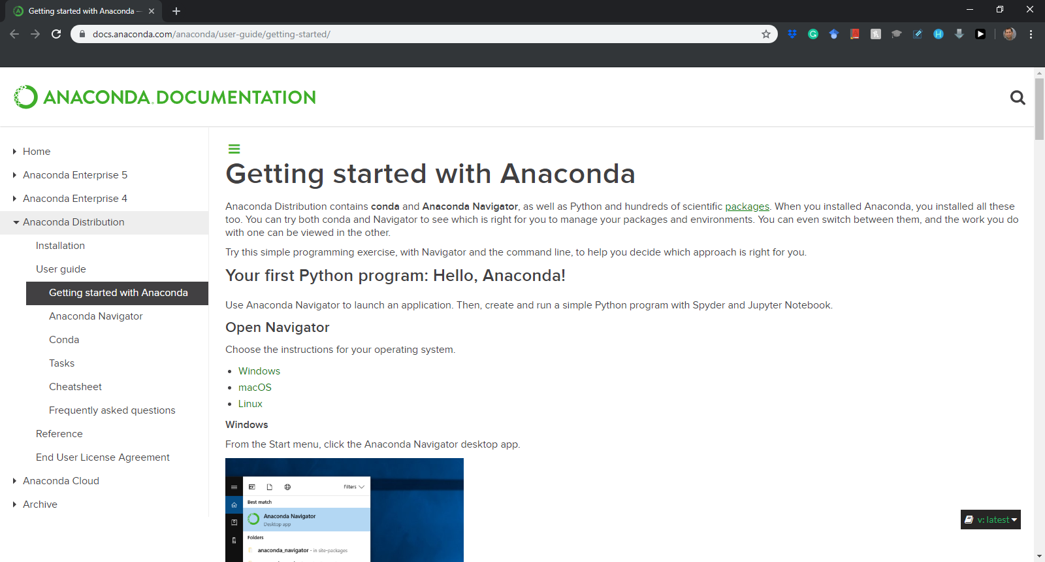
Installation Process
Notes:
https://docs.anaconda.com/anaconda/user-guide/getting-started/

Slide 63
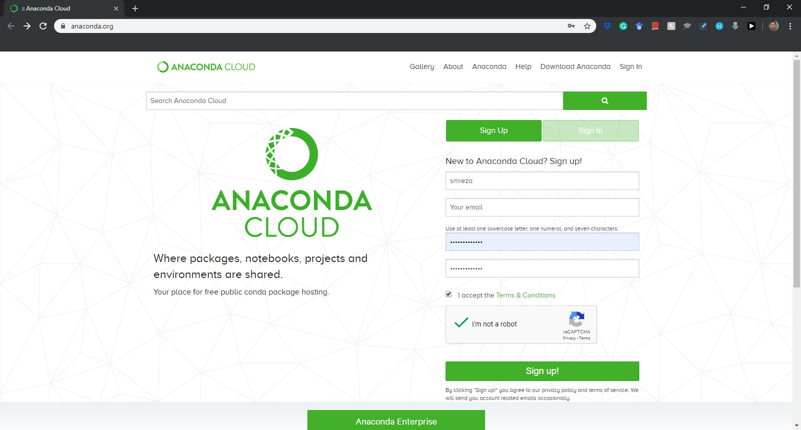
Installation Process
Sign up for the first time….
Notes:
https://anaconda.org/

Slide 64
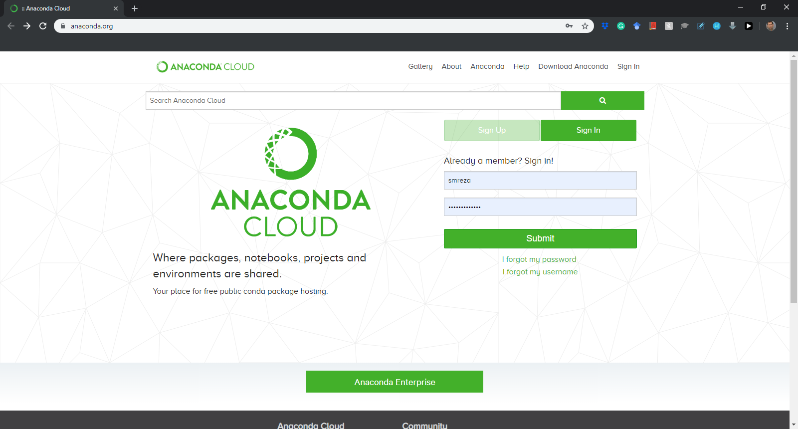
Installation Process
Sign in after the first time….
Notes:
https://anaconda.org/

Slide 65
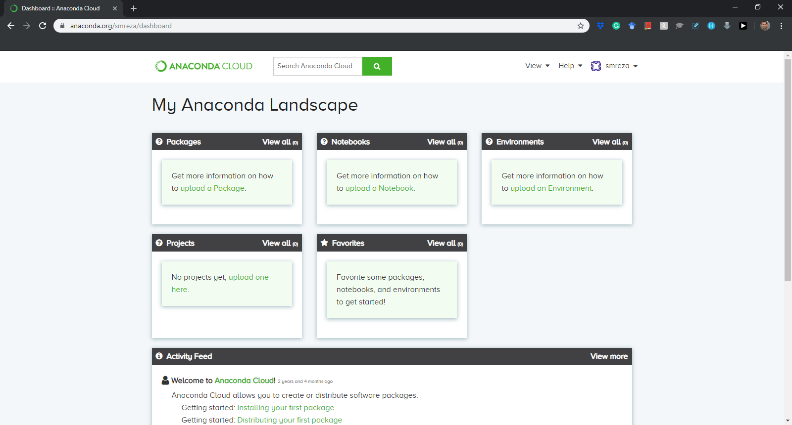
Installation Process

